Slide 1

Module 3.7
IEC Language : FBD

Slide 2
IEC Language FBD
Notes:
This page intentionally blank

Slide 3
Overview
Function Block Diagram consists of a Graphical Free Form Editor that is Data Flow oriented.
FBD Sections have a grid behind them. The FBD programming language is not cell oriented, but the objects are still aligned with the grid coordinates.
Complies with the IEC 61131-3 standard
Particularly suitable for Continuous or Discrete Control Applications
Language consists of reusable Elementary and Derived Function Blocks, Program Elements, Macros and Data Structures
An FBD Section contains 30 horizontal and 23 vertical grid units
Notes:
2

Slide 4
Overview (cont)
The objects of the FBD (Function Block Diagram) programming language help to divide a Section into a number of:
  EFs and EFBs (Elementary Functions and Elementary Function Blocks)
  DFBs (Derived Function Blocks)
  Procedures and
  Control Elements
These objects, combined under the name FFBs, can be linked with each other by:
  Links or
  Actual Parameters
Comments can be provided for the logic of the Section with text objects

Slide 5
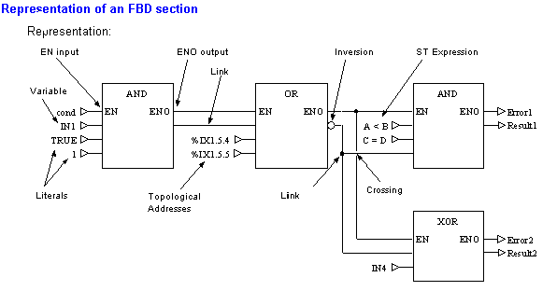
FBD Example

Slide 6
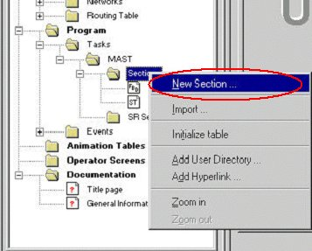
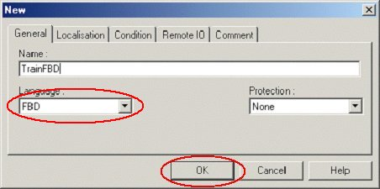
Creating a section
1 - Right-click and select
2 - Select FBD
3 - Validate

Slide 7
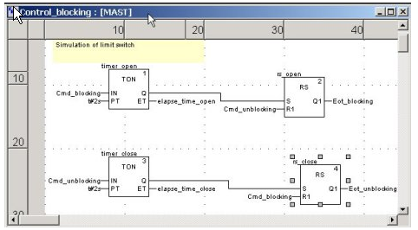
FBD Editor
Freeform editor based on windows multiple document interface
Based on a grid (36 columns x 24 rows)
FBD programming not cell oriented but possible to align with the grid units

Slide 8
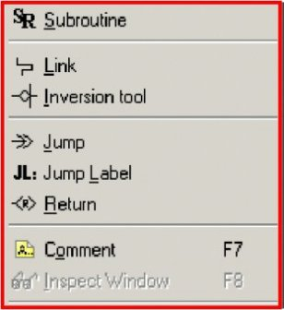
Programming object
There are 3 methods of accessing FBD Programming Objects:
  Click “Edit”, then “New” …….

Slide 9
Programming object (cont)
There are 3 methods of accessing FBD Programming Objects:
  Click “Edit”, then “New” …….
  Use the FBD Objects Toolbar

Slide 10
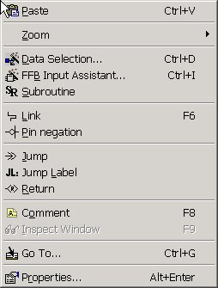
Programming object - Right click
There are 3 methods of accessing FBD Programming Objects:
  Click “Edit”, then “New” …….
  Use the FBD Objects Toolbar
  Place the cursor in the Logic Editor Window, then Right Click to select Object groups

Slide 11
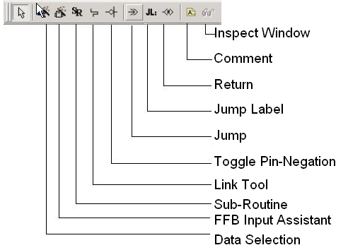
Programming object (cont)
Inspect Window
Comment
Return
Jump Label
Jump
Toggle Pin-Negation
Link Tool
Sub-Routine

Slide 12
Programming rules
Variables
  Entered directly, with the data selector or by drag and drop from the data editor
Elementary function, Elementary Function Blocs or Derived Function Block
  With the data selector or by drag and drop from the libset browser
  Possible to have a FFB input assistant
Loop planning (see comment)
  Configuring loops exclusively via links not permitted
  Resolved using feedback variables
Link with string type (see comment)
  Connect the output of one FFB to the input of another one, not permitted
  Resolved using intermediate variable
Notes:
Non-permitted Loops via Links
Loop generated with an actual parameter : Type 1
Loop generated with an actual parameter: Type 2
Non-permitted link with the String type
Using the intermediate variable

Slide 13

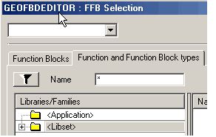
Insertion of Function Block
To insert a Function Block into an FBD Section:
  Create a new FBD Section
  Click on FFB Icon on toolbar
  Select "Function and Function Blocks" Tab
  Under Libset - Base Library - Logic, select AND_BOOL and click OK.
  Place the AND_BOOL Block where you want.
  Assign the Variables to the pins (inputs/outputs)
Graphics continued on next Page

Slide 14
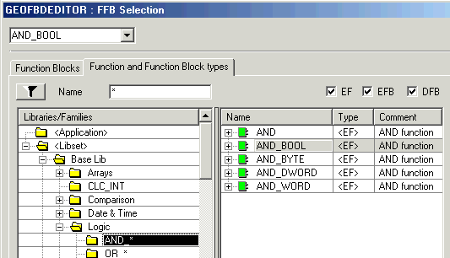
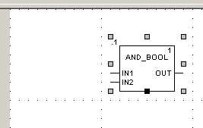
Insertion of Function Block (2)

Slide 15
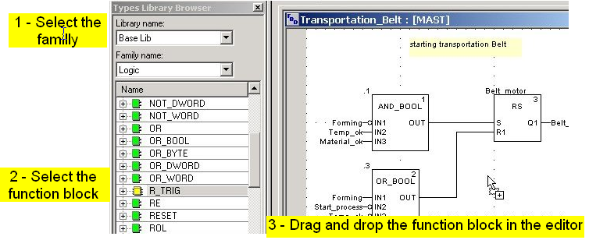
Insertion of FFBs (3)
Possible to insert the function blocks directly by drag and drop from the library browser

Slide 16
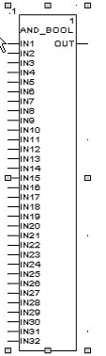
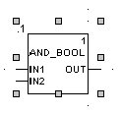

Extendable
How many pins do you need?
Just grab the bottom of the function
block and extend
Up to 32 pins!

Slide 17
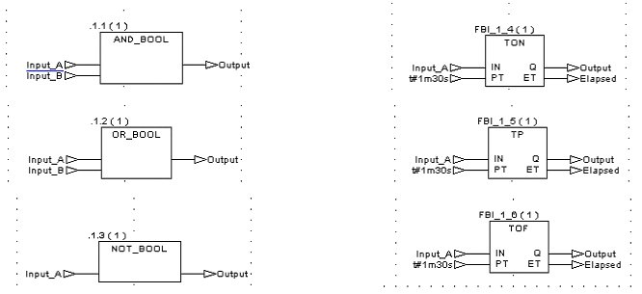
Basic Logic and Timing Functions

Slide 18
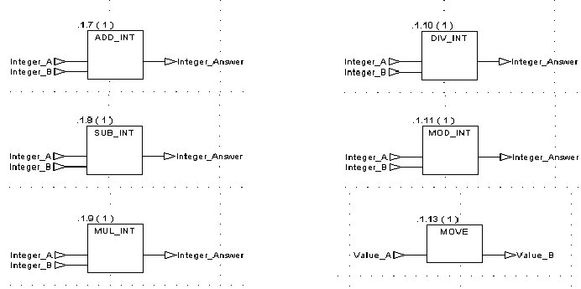
Basic Math Functions

Slide 19
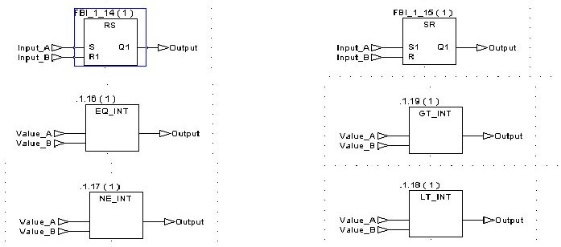
Basic Latches and Comparisons

Slide 20
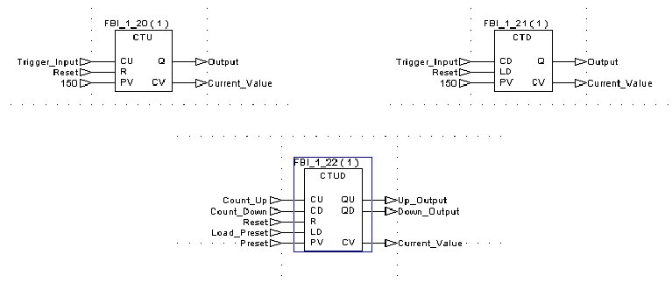
Basic Functions Counters
Notes:
Note that IEC counters do not stop counting when they reach their count-out or preset value, but will continue to accumulate counts.

Slide 21

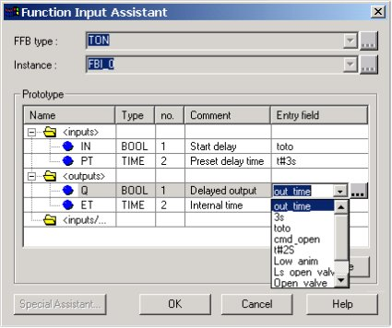
FFB input assistant
Press the assistant icon
Select the FFB by
  the type
  the instance
Note : Instance created automatically if FFB selection by the type
In Entry field, select for each input and output, the variable
Press Insert button to validate
2
3
4

Slide 22
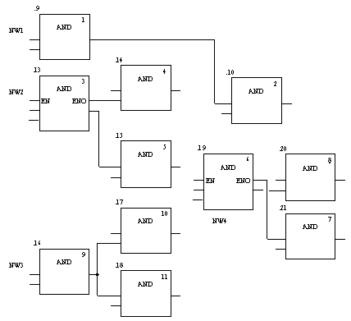
Execution Sequence
To the left is an example of the Execution Sequence of Objects in an FBD Section.
The execution sequence is determined by the position of the FFBs within the Section (executed from left to right and from top to bottom). If the FFBs are linked graphically, the execution sequence is determined by signal flow.
The execution sequence is indicated by the execution number (number in the top right corner of the FFB frame).
See additional Comments
Notes:
Execution Sequence on Networks
For network execution sequences, the following rules apply:
Executing a section is completed network by network based on the FFB links from above and below.
Links may not be used to create loops since the sequence of execution in this case cannot be clearly determined. Loops must be created using actual parameters.
The execution sequence for networks that are not linked is determined by the graphic sequence (from top-right to bottom-left). This execution sequence can be influenced.
Processing on a network is ended completely before the processing begins on another network for which outputs are used on the previous network.
No element of a network is deemed to be processed as long as the status of all inputs of this element are not calculated.
Processing on a network is only ended if all outputs on this network have been processed.

Slide 23
See comment
Notes:
Signal Flow Within a Network
For execution sequences within a network, the following rules apply:
An FFB is only processed if all elements (FFB outputs, etc.) with which it’s inputs are linked are processed.
The execution sequence of FFBs that are linked with various outputs of the same FFB runs from top to bottom.
The execution sequence of FFBs is not influenced by the location within the network.
This does not apply if more than one FFB are linked to the same output of the "calling" FFB. In this case, the execution sequence is determined by the graphic sequence (from top to bottom).
Priorities
Priorities in Defining the Signal Flow Within a Section:

Slide 24
Change Execution Sequence
The order of execution in networks and the execution order of objects within a network are defined by a number of rules. In some cases, the execution order suggested by the system should be changed.
The procedure for defining/changing the execution sequence of networks is as follows:
  Using Links Instead of Actual Parameters
  Network Positions
  Explicit Execution Sequence Definition
The procedure for defining/changing the execution sequence of objects within a network is shown on the following slides
FFB Positions
See Examples of these Rules under Comments
Notes:
Original Situation
The figure shows two networks for which the execution sequences are only defined by their position within the section, without taking into account that block 0.4/0.5 and 0.7/0.8 require another execution sequence

Slide 25
See comment
Notes:
Link Instead of Actual Parameter
By using a link instead of a variable the two networks are run in the proper sequence. (see also Original Situation)
Network Positions
By using a link instead of a variable the two networks are run in the proper sequence. (see also Original Situation)

Slide 26
See comment
Notes:
Explicit Definition The correct execution sequence can be achieved by explicitly changing the execution sequence of an FFB. FFBs for which the execution order has been explicitly changed receive an additional entry of the instance name/function number of the previously executed FFBs in front of the execution number. (see also Original Situation)
FFB Positions
The position of FFBs only has an influence on the execution sequence if more than one FFB is linked to the same output of the "calling" FFB. (see also Original Situation)
In the first network, block positions .4 and .5 are switched. In this case (common origins for both block inputs) the execution sequence of both blocks is switched as well (processed from top to bottom).
In the second network, block positions .7 and .8 are switched. In this case (different origins for the block inputs) the execution sequence of the blocks is not switched (processed in the sequence that the block outputs are called in).

Slide 27
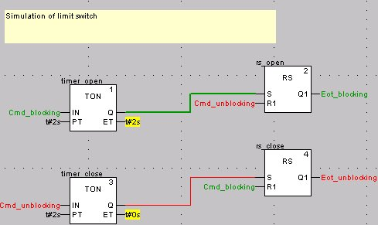
Debugging
Animation of FBD section :
  Boolean variable is true : Green
  Boolean variable is false : Red
  Other variable types : Yellow
  Link animated in case of boolean type (red or green)
  Numerical value or string directly displayed

